Slide 1
What, if Anything, Can the U.S. do to Help Bring About Peace in Iraq & Syria?
Barbara F. Walter
GPS / UCSD

Slide 2
Background Articles:
“Escaping the Civil War Trap in the Middle East.” The Washington Quarterly, Summer 2015.
“Why Obama’s Middle East Policy is Failing” The Wall Street Journal, February 2016.

Slide 3
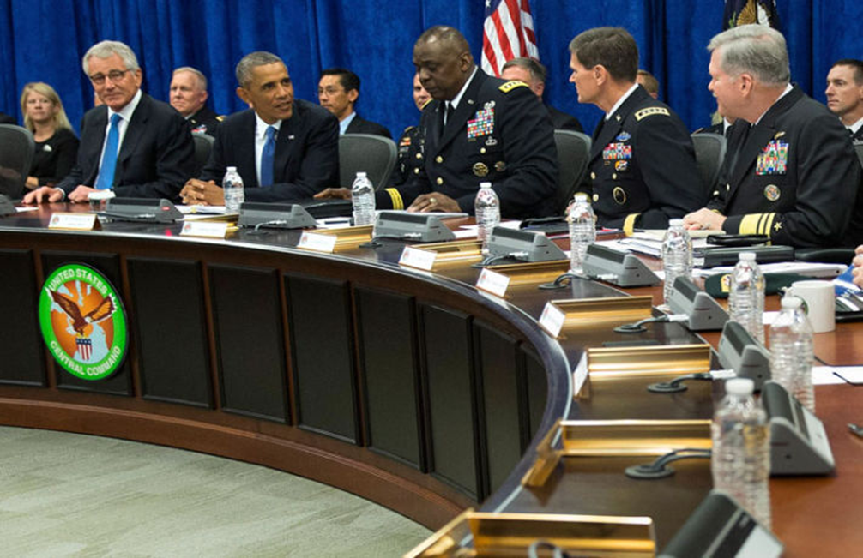
“What aren’t we thinking about that we should be thinking about?”

Slide 4
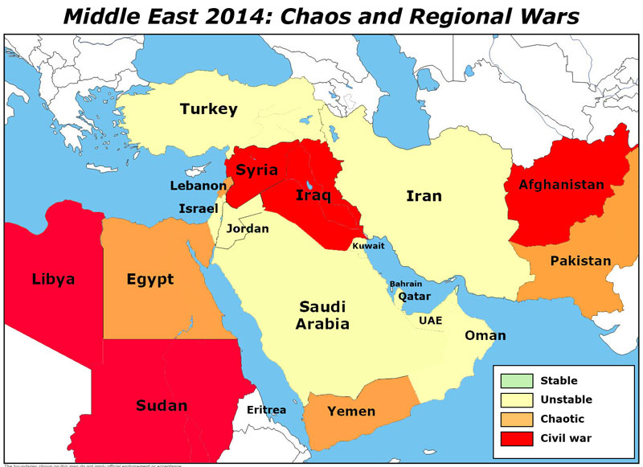
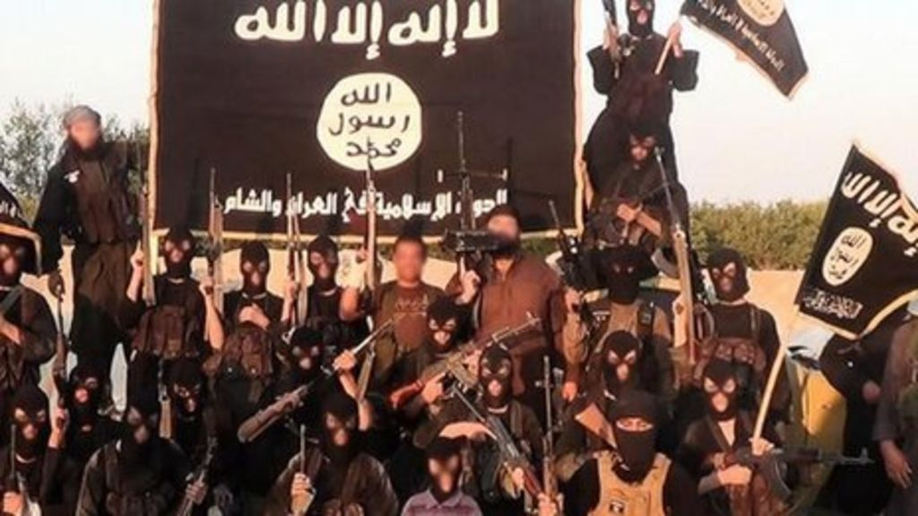
My Answer:
Less about ISIS
Think More about
Civil Wars

Slide 5
Why?
The current policy the US is following in the Middle East right now -
the one where we are focused almost entirely
on defeating ISIS
- is doomed to fail.

Slide 6
Why?
Because we’re not focused on eliminating the conditions that allow ISIS to thrive.
  The instability and chaos created by civil wars.

Slide 7
Over the last 20 years, there’s been an enormous amount of research done on civil wars.
We now know:
    what makes states more likely to experience civil wars,
    what causes civil wars to last as long as they do,
    what’s needed to end them in negotiated settlements.

Slide 8
We also know that civil wars create lots of “negative externalities”:
      Reduce economic growth.
      Make weak states weaker.
      Create large-scale humanitarian crises – refugees etc.
      The contagion effect.
      High recidivism rates.

Slide 9
In terms of extremism:
We know that civil wars make it easy for extremist groups to organize, operate and spread.
  Al Qaeda couldn’t make a dent in Saudi Arabia or Egypt until it fled to Afghanistan where it thrived in that civil war.
  It then set up franchises wherever civil wars existed.
  Now, the main terrorist threats from al Qaeda are located entirely in states with civil wars: Syria, Iraq, Afghanistan, Pakistan, Yemen, Libya, Somalia and Mali.
  The same is true with ISIS. ISIS’s predecessor – Al Qaeda Iraq – was basically eliminated in Iraq by 2011 until the civil war in neighboring Syria gave it a new safe haven.

Slide 10
So what does this research tell us about the Middle East?

Slide 11
The U.S. has a much bigger problem than ISIS. (In fact, ISIS is just a symptom of that larger problem.)
The longer the civil wars continue, the more likely they are to spread.
  Egypt, Jordan, Lebanon, Iran and Saudi Arabia could all be destabilized.
The longer the civil wars continue, the more refugees will be produced.
  This not only creates a deep humanitarian crisis, but is also destabilizing to neighboring countries and Europe.
Even if we defeat ISIS, the conditions that gave rise to it will continue to exist. A new group, or ISIS 2.0, will simply re-emerge.

Slide 12
So what should the US do?
Some scholars and policymakers (Steve Walt at Harvard’s Kennedy School or Scott McConnell at the American Conservative) have advocated that we walk away from the Middle East – “let the region determine its own fate”.
But the longer the civil wars lasts, the more problems they will create. And these problems directly affect US interests.
So ignoring the current wars would almost certainly mean more war, not less.

Slide 13
Instead…
The U.S. should be serious about creating the conditions for successful negotiated settlements in the existing civil wars.
This is possible…

Slide 14
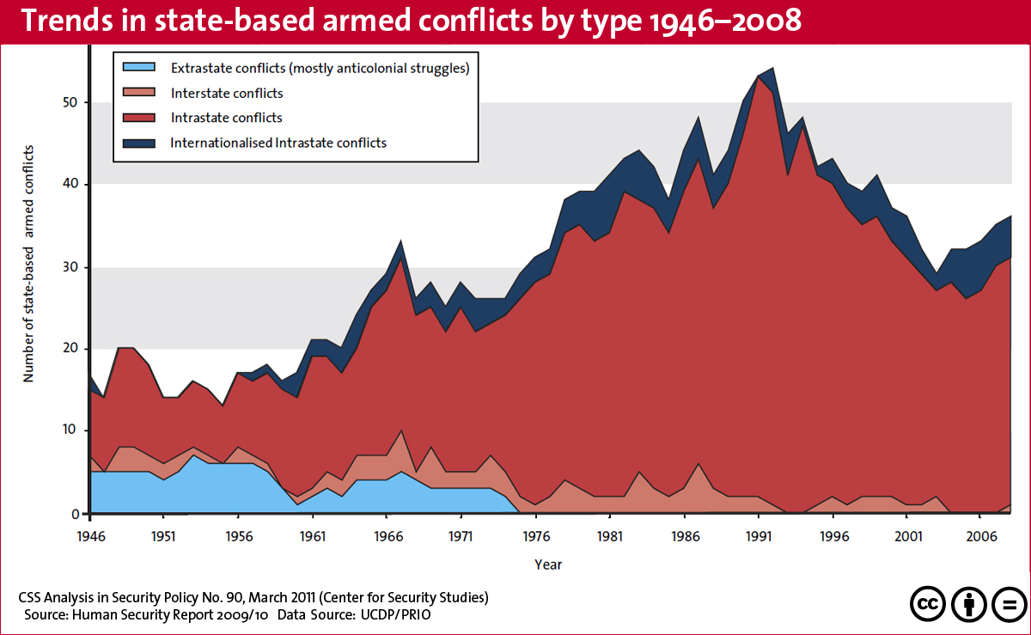

Slide 15
What we learned from the data:
Negotiated settlements are possible but require that all the parties prefer a negotiated settlement to continued war.
    This requires:
    That no side believes it can gain an outright victory at an acceptable cost.

Slide 16
Historically, what has been necessary for successful negotiated settlements?
A military impasse. All parties have to believe that continued war will be extremely costly and risky.
An end to unconditional outside support.
Key factions given a stake in the new gov’t. Power-sharing is given to all parties (including hated elites) and there are clear protections for all groups (including minorities).
A self-enforcing agreement.
    Territorial autonomy for the main sectarian groups.
    A professional, indigenous military where power is distributed among the different fighting factions.

Slide 17
Is this possible in Iraq & Syria?
Yes.
As the civil wars drag on, the main financers (Russia, Iran & Saudi Arabia) will realize that there’s no easy military solution, and a negotiated settlement will look more attractive to them.
Most combatants, in most civil wars eventually agree to negotiate.

Slide 18
This is where the US comes in. The US can:
  Help craft a deal. What will that take?
    Convince Russia (and Assad) they cannot win. Give more military support to the opposition.
    In the absence of military support, then there’s a deal to be made with Russia over Ukrainian sanctions.
    Put pressure on SA and the Persian Gulf States to stop financing ISIS.
  Insist that any negotiated settlement include real power-sharing that can be enforced over time, or real territorial autonomy.
  Consider supporting a peacekeeping force.

Slide 19
Bottom line:
Focusing on defeating ISIS will not solve the larger problems that gave rise to it.
If the US (and the int’l community) refuse to deal with the civil wars raging in the region, these wars will continue and spread, undercutting whatever other strategy we are pursuing.
Any Middle East strategy that wants to reduce terrorism has to have ending the civil wars as its main focus, not ISIS or any other issue.

